Slide 1
STAT7001 – Computing for Practical Statistics 2015 Lecture 8
Model and Method Validation
Dr Franz J. Király

Slide 2






The Scientific Method
Observation
Hypothesis
Prediction
Experiment

Slide 3
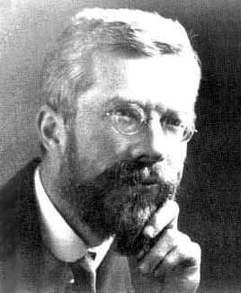


The Scientific Method for Statistical Modelling
Observation
measure data
Hypothesis
choose model
Prediction
estimate/learn model
evaluate/validate model
Experiment
Action

Slide 4


Example: Predicting the future

Slide 5


Example: Predicting the future

Slide 6
Example: Predicting the future

Slide 7

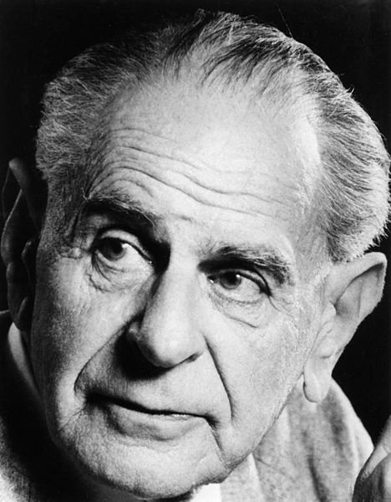
Which model/method is best?
Occam‘s razor = law of parsimony:
Frustra fit per plura quod potest fieri per pauciora.
William of Ockham, in: Summa Totius Logicae
Entia non sunt multiplicanda praeter necessitatem.
A more popular rephrasing by John Punch
= the simplest model/most intuitive method is best
Problem: what does „simple“ or „intuitive“ mean?
Falsifiability/prediction strength:
[a good model] must accurately describe a large class of observations on the basis of a model that contains only a few arbitrary elements, and it must make definite predictions about the results of future observations.
S. Hawking (after K. Popper), in: A Brief History of Time
= the simple model with lowest (prediction) error is best
Problem: how to predict the prediction error?

Slide 8
Occam‘s razor (semi-quantitative version)
best fit
error
generalization error
overfitting
underfitting
training error
model complexity

Slide 9
Model Validation

Slide 10












Predictive models
Supervised Learning:
some data is labelled by expert/oracle
?
?
?
Task: predict label from covariates
statistical models are usually discriminative
Examples: regression, classification

Slide 11
























Validation of predictive models
?
„test labels“
„the truth“
generalizability assumption
„test data“
compare & quantify
„hold-out “
„out-of-sample“
„in-sample“
Model estimation
Prediction
??
e.g. regression, GLM, advanced methods
e.g. evaluating the regression model
„training data“
predictor
predictions
Always validate predictive models out-of-sample!
The only way to test goodness of prediction is actually observing prediction!
Training and test data are obtained by splitting /subsampling the data set
Example validation scheme: uniformly random 80/20% train/test split

Slide 12





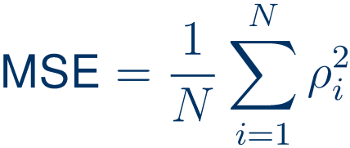
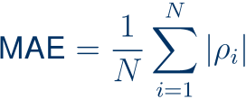


Quantification of prediction goodness
given
test data
„true“ test labels
(held out)
predictor
model predictions
Regression = predicting a continuous/numerical value
Statistics derived from distribution of prediction residuals
(relative version)
root mean squared error
mean squared error
mean absolute error
= residual standard deviation
= residual variance
= mean absolute residual
MSE, RMSE and MAE come with their respective sample standard errors
Comparison of multiple predictors: hypothesis testing on residual distributions
(includes types of error bar criteria)
Classification = predicting a categorical variable
Statistics derived from classification contingency table of predicted vs true value
Sensitivity, specifity, predictive values, accuracy, precision, tau-statistic
Comparison of multiple predictors: hypothesis testing on contingency tables
Always obtain error bars and significances when quantifying

Slide 13
Cross-validation and model comparison
Validation blue-print:
training data
residuals
Prediction and error estimation
error measure
all data
e.g. RMSE
test data
Model comparison:
training data
Predictor 1
residuals 1,2,3
Predictor 2
errors 1,2,3
all data
e.g. RMSE 1,2,3
test data
Predictor 3
comparison
to be done on same train/test split
Cross-validation:
training data 1
Predictor 1
errors 1,2,3
Predictor 2
test data 1
Predictor 3
training data 2
Predictor 1
errors 1,2,3
aggregate errors 1,2,3
all data
Predictor 2
test data 2
Predictor 3
training data 3
Predictor 1
errors 1,2,3
Predictor 2
test data 3
Predictor 3
comparison
re-sampling of multiple train/test splits allows more accurate and stable estimation
all methods need to be evaluated on the same cross-validation splits

Slide 14
Cross-validation:
training data 1
Predictor 1
errors 1,2,3
Predictor 2
test data
Predictor 3
training data 2
Predictor 1
errors 1,2,3
aggregate errors 1,2,3
all data
Predictor 2
test data
Predictor 3
training data 3
Predictor 1
errors 1,2,3
Predictor 2
test data 3
Predictor 3
comparison
Aggregation:
errors by mean
cave: means inside MSE are computed per re-sampling
error variances by mean (conservative)
or sample-corrected (may underestimate)
type of cross-v.
how to obtain training/test splits
pros/cons
1. divide data in k (almost) equal parts
good compromise between
k-fold
2. obtain k train/tests splits via:
runtime and accuracy
often: k=5
each part is test data exactly once
the rest of data is the training set
when k is small compared to data size
leave-one-out
= [number of data points]-fold
very accurate, high run-time
repeated sub-sampling
1. obtain a random sub-sample of
can be arbitrarily quick
training/test data of specified sizes
can be arbitrarily inaccurate
(train/test need not cover all data)
parameters: training/test size # of repetitions
(depending on parameter choice)
2. repeat 1. desired number of times
can be combined with k-fold

Slide 15
Subsampling in R and SAS
in R: via the sample function
set.seed(4242)
set.seed initializes random seed
testdata <- sample(fulldata,size,replace=FALSE,…)
gives a random subsample of size size, e.g. round(length(fulldata)/5)
For more information on subsampling in R, type help(sample)
in SAS: via the PROC surveyselect
PROC surveyselect data=fulldata method = SRS rep = 1
sampsize = size seed = 4242 out = testdata;
id etc;
list of variables to include
sample size is size
run;
output subsample is testdata
For more information on subsampling in SAS, type help surveyselect
for k-fold cross-validation:
draw a datasize sample without replacement
the result will be the whole data set, but in uniformly random order (permutation)
divide the permutation in k equal parts to obtain the cross-validation folds
Always set the random seed for reproducibility of your results!

Slide 16
Out-of-sample predictions in R and SAS
in R: via the predict function
available for most classes of models, e.g. lm
lmmodel <- lm(etc, data = dataset[trainspl,])
predictions <- predict(lmmodel, data = dataset[testspl,])
For more information on prediction in R, type help(predict.modelname)
in SAS: varies; often by abusing in-sample prediction features
e.g. by putting missing values for the predicted variable in the test sub-sample
PROC reg data=testdata;
the regression target is targetvar
model targetvar = etc ;
output out = pred_data(where=(targetvar=.))
run;
p = targetvar_pred etc;
this creates a data set pred_data
containing the the same variables as testdata
plus a variable targetvar_pred that contains the predictions
at positions where the variable targetvar is missing
combine this with appropriate surveyselect statements

Slide 17

Descriptive models
Unsupervised Learning:
the data comes without labels
?
?
!
!
Task: find a parsimonious description for the data
statistical models are usually generative
Examples: parametric estimation, dimension reduction, clustering

Slide 18







Generative models: parametric estimation
Estimator

Slide 19





Validation of descriptive models
Estimator
Model
in-sample-goodness is fine for descriptive purposes
but when assessing/claiming generalizability:
Always validate goodness of model out-of-sample!
for example: goodness-of-fit on test data
likelihood on test data
variance explained on test data

Slide 20


Computing the MLE in R and SAS
Unfortunately, you will have to do it yourself, most of the time
Pseudocode: Maximum Likelihood Estimate
Input:
Output:
If explicit formula is available: compute, and return the MLE
If not: call a numerical optimization routine maximizing
in R: stat4 library has function mle which takes the log-likelihood
in SAS: you need to write your own code and modules
In both cases, you usually have to add a moderate amount of work

Slide 21
Method Validation and Simulation Experiments

Slide 22
How does one test a test/method/estimator?
Control for everything that is not the test/estimator/method!
1. Fix a known ground truth
Method
2. Simulate data according to 1.
3. Run method on data from 2.
4. Compare output from 3. to ground truth in 1.
Repeat a number of times to estimate output distribution!
If your method works on samples, this means two loops: one for the input sample, and one for the outputs
Repeat for different, representative ground truths, sample sizes

Slide 23
Random Sampling in SAS and R
in SAS: via the rand function, in a DATA step
DATA sample(keep = x);
x is the sample variable to keep
call streaminit(4242);
streaminit initializes random seed
do i = 1 to splsize
the sample size is splsize
x = rand("distribution",…)
parameters of rand specify distribution
output;
for example, "Normal"
this writes a new data row
end;
run;
Consult chapter I.2 of Wicklin: Simulating Data With SAS for details
more distributions supported in randgen function in SAS/IML
in R: sampling is done via separate functions
set.seed(4242)
set.seed initializes random seed
sample <- rdistribution(splsize,…)
for example, rnorm(splsize)
See section 3.3 of Maindonald/Braun or use the help function

Slide 24


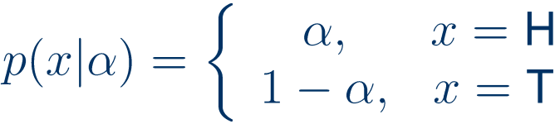











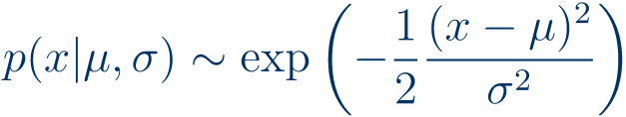


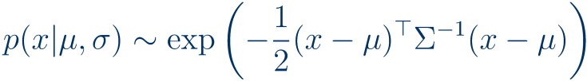

Important Parametric Distributions

Slide 25
A reference table for random sampling
Distribution
SAS argument of rand
R function
Uniform
"Uniform"
runif
Normal/ Gaussian
"Normal"
rnorm
Poisson
"Poisson"
rpois
Binomial
"Binomial"
rbinom
Multinomial
randmultinomial
rmultinom
Gamma
"Gamma"
rgamma
Other
Wicklin, section 2.7
help(Distributions)

Slide 26

Sampling from a custom CDF
Idea: sample from uniform instead, transform scale
Pseudocode: Inverse Transform Sampling
Input:
none
Output:
1. set the random seed
2. sample x from the uniform distribution on [0,1]
3. return
x
x
(lecture 7)
in SAS: section 7.4 of Wicklin
in R: write inverse function, sapply inverse function to runif

Slide 27
Assessing your methods
further information you can obtain from your random variable:
SAS
R
Probability density function
pdf(…)
ddistribution(…)
Cumulative distribution function
cdf(…)
pdistribution(…)
Inverse CDF/quantiles
quantile(…)
qdistribution(…)
(replace r… by d/p/q…)
Test your sampler by comparing ground truth to empirical sample
Test your method by comparing ground truth to empirical result
Always obtain more than one output point!
(especially important if your method takes a sample and outputs a scalar)
Comparing empirical to generative/ground truth distributions:
Qualitative comparison: histogram/density estimate versus true distribution
qq-plot theoretical versus sample quantiles
Quantitative goodness-of-fit tests: Kolmogorov-Smirnov, Cramér-von-Mises, …

Slide 28
Validation Workflows

Slide 29
Validating one or more particular models
e.g. predictors
1. Define the task that the model addresses:
for a particular outcome
what is the model supposed to do?
e.g. predict pulse, type of object, etc
2. Select appropriate measure(s) of goodness/error:
when is the result considered good?
e.g. good = low RMSE or MAE
3. Estimate error out-of-sample for model and baselines:
how well is the model actually solving the task?
e.g. CV-estimate RMSEs
4. Quantiatively compare model(s) and baselines:
is the model better than a random guess?
e.g. Wilcoxon signed rank test on absolute residuals
is the model better than much simpler models?
Validating a method
e.g. an estimator, a new class of predictive models
A. Validate method repeatedly on synthetic data:
e.g. on synthetic linear data
does the method solve the task when its assumptions are satisfied?
B. Validate method on real world data set:
is the method practically useful?
is there quantitative evidence that anyone should bother?
Always validate out-of-sample!
Always compare to naive baselines and state-of-the-art!

Slide 30
Next Week: Non-Linear Fitting
Fitting specific models that are not (general) linear
Non-linear model selection and model assessment

Slide 31
Week 8 Learning Objectives
Sampling and samples in R and SAS
Sub-sampling and re-sampling of data sets
Sampling from built-in and custom distributions
Obtaining training/test splits
Validation of Predictors
How to validate out-of-sample
Experiments for error estimation
Prediction residuals and model comparison
Validation of Methods
Creation of synthetic data for method validation
Synthetic validation experiments

